Slide 1
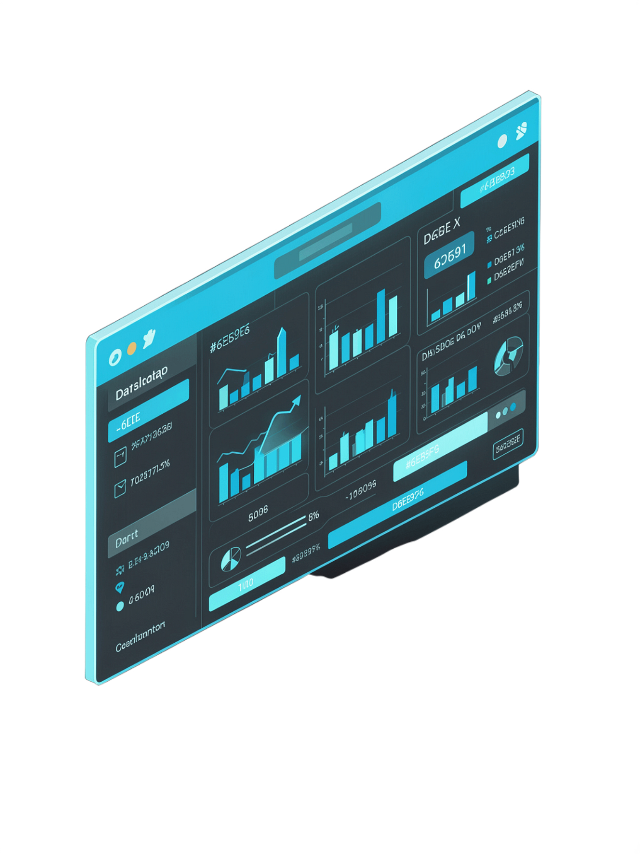

Interactive EDA Dashboard
Data Science (24AD3107) | Academic Year 2026–2027
Team Members
Y. Revanth (2420030605)
G. Rithwik (2420030415)
A. Nikitha (2420030505)
Project Guide
Dr. N. Sunanda

Slide 2

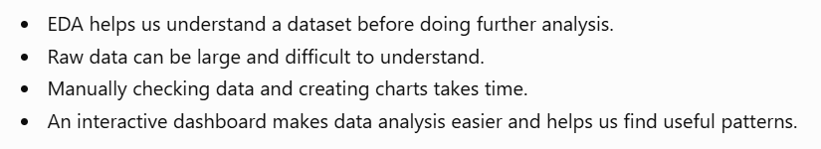
What is Exploratory Data Analysis?
Data Exploration
Raw Dataset
Visualization
Insights

Slide 3

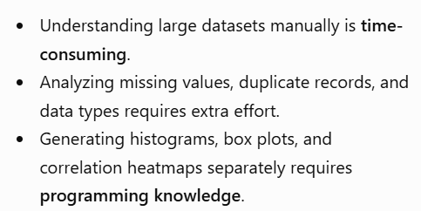
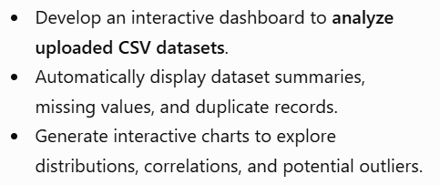
Problem Statement & Objectives
Challenges
Our Goals

Slide 4
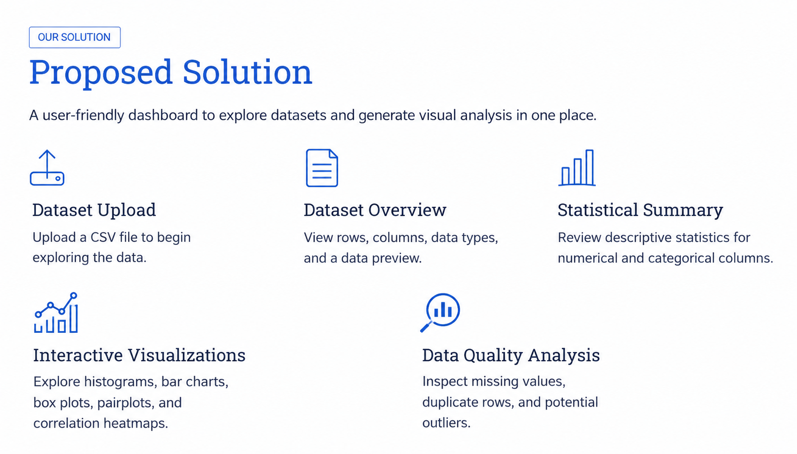


Slide 5
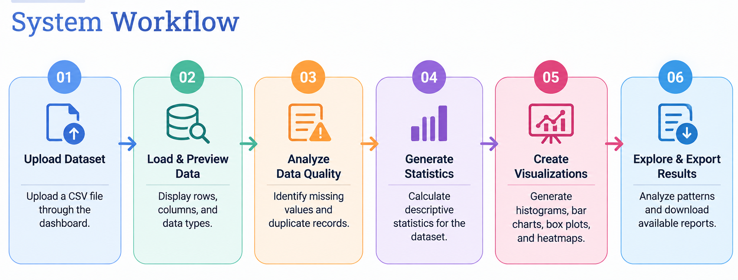

Slide 6
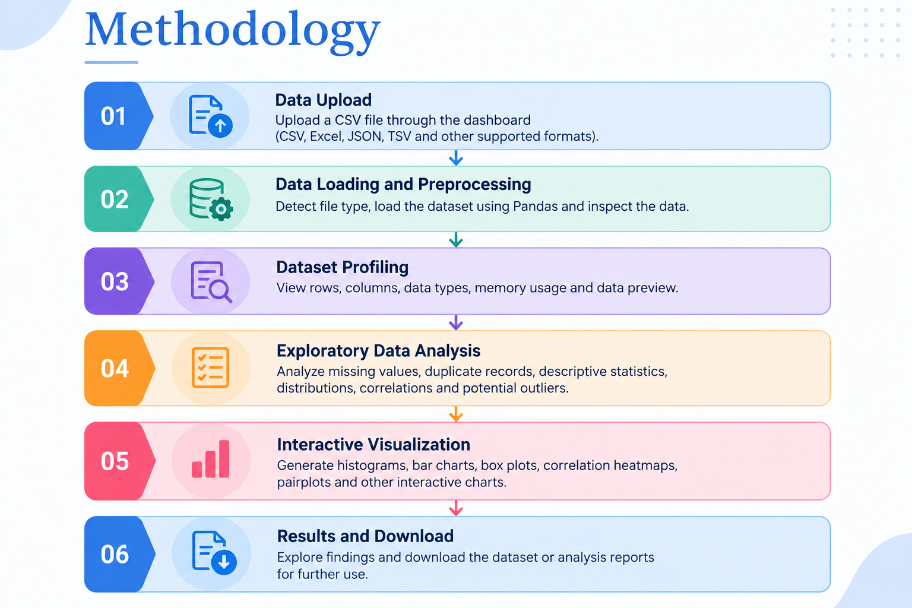


Slide 7
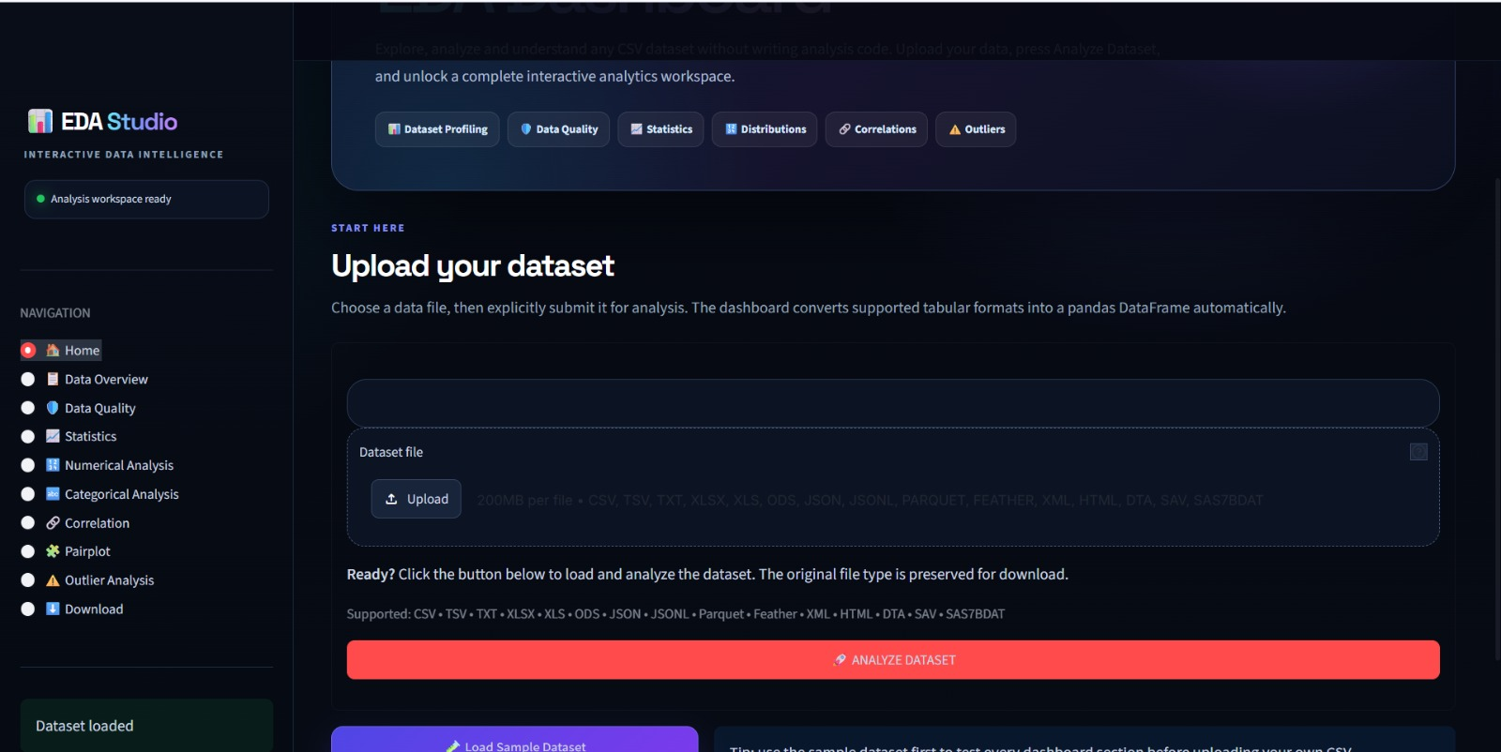
Implementation Results & Dashboard Outputs

Slide 8
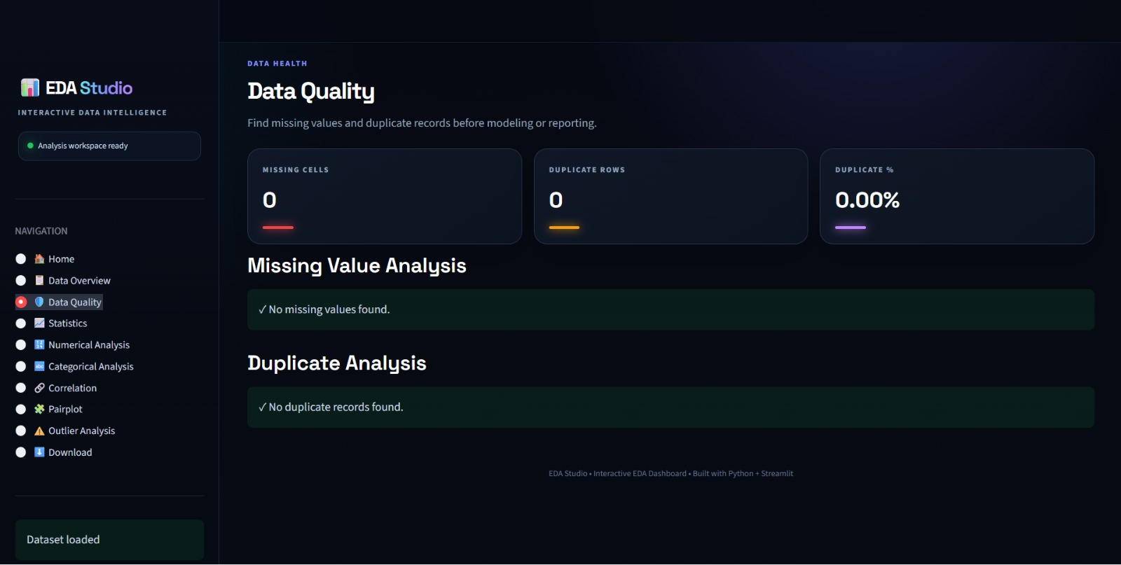


Slide 9


